Slide 1

Inference
Confidence Interval for Means
Adriano Zambom

Slide 2


General Confidence Interval
Sample Estimate Multiplier Std.Error
or
(SampleE – m x s.e., SampleE + m x s.e.)
Note: Margin of Error: ME = m x s.e.
Adriano Zambom

Slide 3

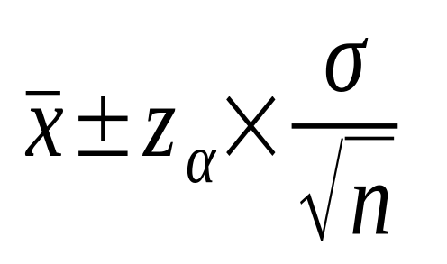

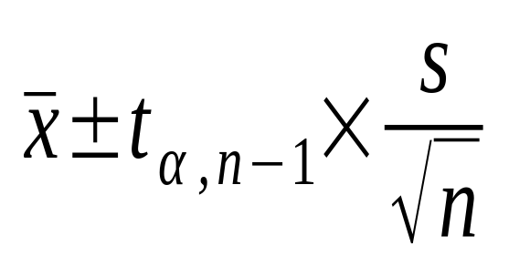
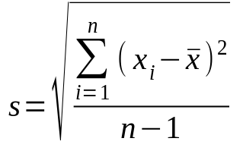

CI for a Population Mean
If the standard deviation is known
  CI for is
If the standard deviation is unknown
CI for is
where
Conditions: or bell-shaped distribution
Adriano Zambom

Slide 4
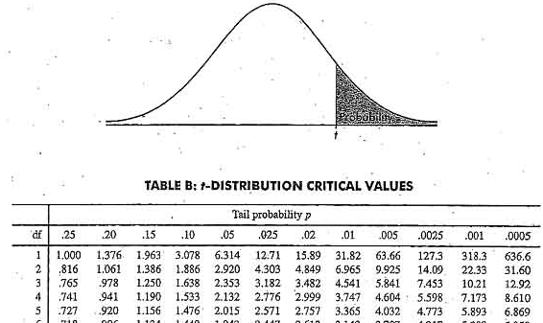
t-distribution
A t-distribution is determined by the degrees of freedom.
In the case of our test, df = n-1
Now, we can find the multiplier in the t-table
Adriano Zambom

Slide 5
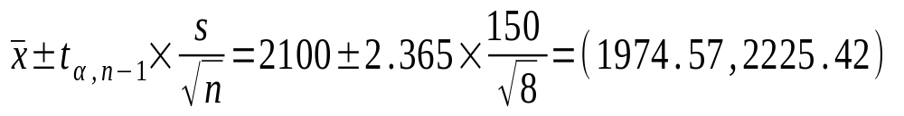
Example
In a contest for who can eat 32 bananas faster, the mean time of finishing up is 2100 seconds(35 min) and the standard error is 150 seconds. If there were 8 participants in the contest, what is the 95% CI for the time to eat 32 bananas?
Therefore, in the long run, of all CI that we compute using 95% confidence level, 95% of them will cover the true population parameter
Adriano Zambom

Slide 6
In R
If I have the data:
x = c(2100, 2180, 2200, 2030, 2186, 2203, 2080, 2111)
t.test(x)
Adriano Zambom

Slide 7



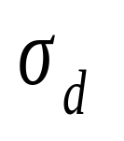
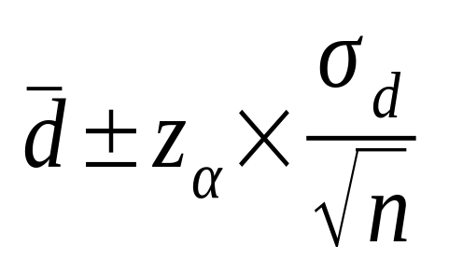
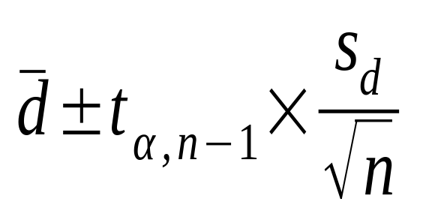
CI for Mean of Paired Diﬀerences
Recall the notation:
If the standard deviation is known
  CI =
If the standard deviation is unknown
CI =
Conditions: or bell-shaped distribution
Adriano Zambom

Slide 8
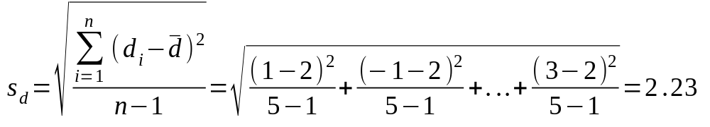
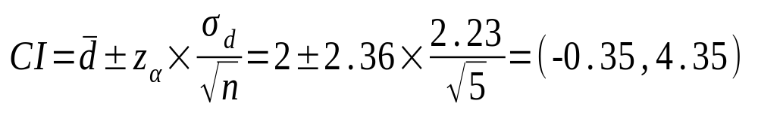
Example
A researcher measures the weight of 4 students, and after a week of diet, he measures again. The goal is to see how much weight they lost by being in the diet. He finds
student | Day 1 | Day 7 | Difference(d)
a | 75 | 74 | 1
b | 63 | 64 | -1
c | 88 | 83 | 5
d | 79 | 77 | 2
e | 67 | 64 | 3
Adriano Zambom

Slide 9
Example
A researcher measures the weight of 4 students, and after a week of diet, he measures again. The goal is to see how much weight they lost by being in the diet. He finds
student | Day 1 | Day 7 | Difference(d)
a | 75 | 74 | 1
b | 63 | 64 | -1
c | 88 | 83 | 5
d | 79 | 77 | 2
e | 67 | 64 | 3
In R:
t.test(x = c(75, 63, 88, 79, 67), y = c(74, 64, 83, 77, 64), paired = TRUE)
Adriano Zambom

Slide 10
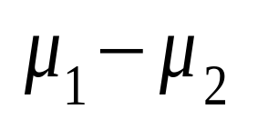
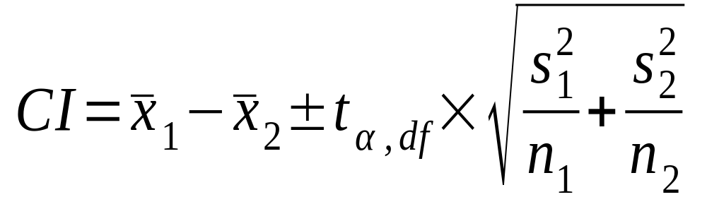
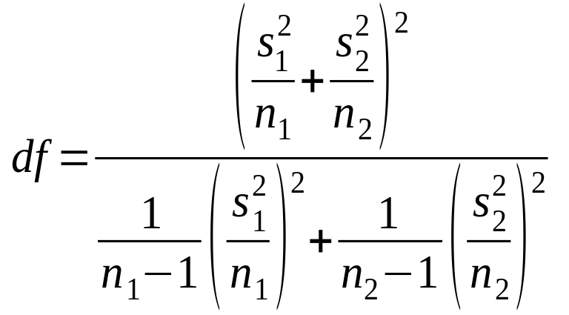
CI for Diﬀerence in Two Sample Means
CI for
Adriano Zambom

Slide 11
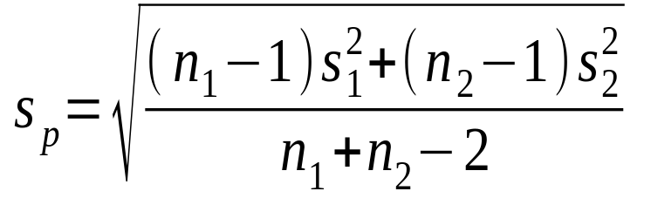
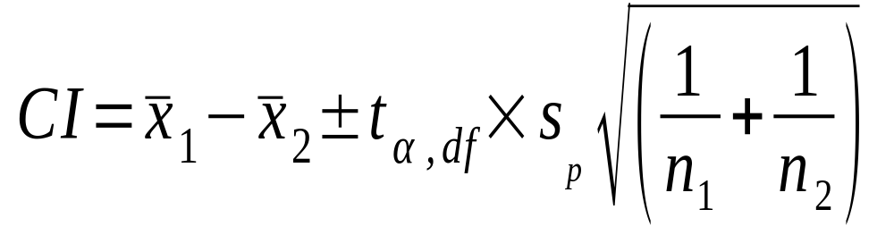
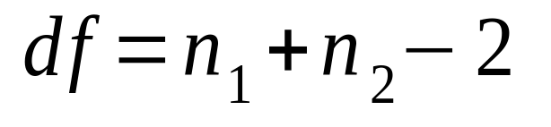
CI for Diﬀerence in Two Sample Means – Pooled Std.Deviation
If we assume that the standard deviation of the two populations is the same, then we can use the pooled standard error to estimate it:
And then the CI becomes:
Note that
Adriano Zambom

Slide 12

Example
Suppose we measure the blood pressure of 12 people who use drugs and of 21 people who don’t use drugs. The mean blood pressure of the first group is 150 with std dev 8 and the mean of the second group is 100 with std dev 9. What’s the Ci for the difference?
Adriano Zambom

